Slide 1

Bachelor’s of Technology in EXTC
Project Phase- II, Mid Term Progress Presentation
Academic Year 2025-26
Semester VII
SVKM’s NMIMS
Mukesh Patel School of Technology Management and Engineering, Vile Parle, Mumbai- 400056
Department of Electronics & Telecommunication

Slide 2
A PRESENTATION ON
“EVision - Smart Charging Forecasting & Location Planner”
By
Under the guidance of
PROJECT MENTOR NAME
Prof./Dr. Anjana Rodrigues
Yash Joshi | D065 | 70062200095
Tirth Dhandhukia | D058 | 70062200012

Slide 3
Table of Contents
Section | Description
1. Objectives | Goals of building an AI-powered EV charging demand forecasting and location planning system.
2. Introduction | Background on EV adoption challenges and proposed AI-based solution.
3. Motivation | Why smarter, data-driven infrastructure planning is needed.
4. Literature Survey | Review of five research papers with comparative analysis.
5. Problem Statement | Key issues with current EV charging station planning methods.
6. Software Requirements | Tools, frameworks, and technologies used in the project.
7. Methodology | Step-by-step workflow from data preprocessing to deployment.
8. Work Done So Far | Completed modules with current accuracy and dashboard prototype.
9. Results | Visual outputs showing existing vs. predicted charging station locations.
10. Project Plan | Roadmap for improving accuracy, benchmarking models, and publishing work.
11. Acknowledgement | Gratitude to mentor, faculty, and supporting resources.
12. References | Research papers and sources that informed the project.

Slide 4
Objectives
Develop an AI-powered forecasting system to predict future EV charging demand across different city regions.
Leverage advanced models – XGBoost, and K-Means clustering – for accurate time-series and spatial analysis.
Identify high-demand hotspots and recommend optimal locations for new charging stations.
Provide an interactive web dashboard with geospatial visualizations, demand forecasts, and decision-making insights.
Enable data-driven planning for urban developers, EV operators, and policymakers to optimize infrastructure and reduce grid overload.

Slide 5
Introduction
Rapid adoption of Electric Vehicles (EVs) is creating high and unpredictable charging demand in cities.
Existing charging infrastructure often suffers from poor placement, grid overload, and low utilization.
Lack of real-time intelligence leads to inefficient investments and customer dissatisfaction.
Proposed Solution:
  An AI-powered Geo-Intelligent System that combines time-series forecasting and geospatial clustering.
  Predicts where and when EV charging demand will rise.
  Helps planners and operators strategically deploy new charging stations.
Supports smart city development and green mobility goals through data-driven decision-making.

Slide 6
Motivation
EV boom is reshaping urban transportation, but charging infrastructure is not keeping pace.
Poorly placed charging stations cause:
  Underutilization in some areas
  Grid overload & long queues in others
City planners and EV operators lack predictive tools to make informed site selection decisions.
Current methods are reactive and data-siloed, leading to inefficient investments.
Need: A smart, data-driven solution that predicts future demand and recommends optimal charging station locations, ensuring efficient energy distribution and user satisfaction.

Slide 7
Literature Survey:
Table 1 – Comparison with S. Sanami et al. (2023)
Aspect | Existing Paper | Our Project
Technique | Multivariate Time-Series Analysis | SARIMA + XGBoost hybrid model
Scope | Only demand forecasting | Demand forecasting + site recommendation
Spatial Intelligence | Not included | GIS data + K-Means clustering for hotspot detection
Deployment | Academic model, no dashboard | Real-time web-based dashboard for decision-making
Notes:
SARIMA-Captures both short-term patterns (via ARIMA) and long-term seasonality (via seasonal components).

Slide 8
Table 2 – Comparison with M. van Etten et al. (2024)
Aspect | Existing Paper | Our Project
Technique | Global Time Series Modeling | Localized SARIMA + XGBoost
Granularity | Large-scale generalized demand | City/region-specific predictions
Spatial Hotspots | Not addressed | K-Means clustering for localized hotspots
Actionability | Provides demand curves only | Actionable site recommendations with scoring system

Slide 9
Table 3 – Comparison with S. Patsavellas et al. (2022)
Aspect | Existing Paper | Our Project
Technique | Regression and statistical models | SARIMA + XGBoost hybrid model
Model Accuracy | Limited for non-linear trends | Captures non-linear residuals, improving accuracy
Spatial Clustering | Not included | Integrated GIS-based hotspot analysis
Dashboard | No real-time visualization | Interactive geospatial web dashboard

Slide 10
Table 4 – Comparison with S. K. Nayak et al. (2021)
Aspect | Existing Paper | Our Project
Technique | Traditional time-series models | SARIMA + XGBoost
Forecast Scope | Short-term power consumption | Short- & long-term (12 months) forecasts
Non-linear Patterns | Poor handling of fluctuations | Captures complex demand patterns using ML
Spatial Features | Not included | GIS-based clustering and hotspot detection

Slide 11
Table 5 – Comparison with S. Zhang et al. (2023)
Aspect | Existing Paper | Our Project
Technique | Climate-aware time-series forecasting | Hybrid SARIMA + ML with spatial data
Focus | Impact of climate on charging demand | Multi-factor approach (traffic, EV density, grid support)
Spatial Hotspots | Not highlighted | K-Means clustering for hotspot identification
Recommendation | Predictive analysis only | Optimal site selection with scoring mechanism

Slide 12
Problem statement
Rapid EV adoption is straining current charging infrastructure, leading to grid overload, long wait times, and underutilized stations.
Existing planning methods rely on historical data and manual surveys, making them reactive and inefficient.
Most research focuses only onsite selection or only on demand forecasting, not both together.
Lack of an AI-powered tool that combines time-series demand forecasting with spatial analysis for data-driven decision-making.
Urban planners and EV operators cannot accurately predict where future charging demand will surge, leading to poor ROI and inconvenient user experience.

Slide 13
Software Requirements
Frontend Development: JavaScript
Data Processing: Python (Pandas, NumPy)
ML Modelling: Linear Regression, Ridge, XGBoost, GradientBoosting
Clustering: Scikit-learn (K-Means)
Geospatial Visualization: GeoPandas, Folium
Visualization:.Powerbi for web dashboards

Slide 14
Methodology
1. Data Preprocessing
Cleaned, standardized, and normalized raw datasets (charging usage, demand, population, traffic, geospatial).
Handled missing values/outliers to create a consistent dataset.
2. Data Exploration
Generated statistical summaries, correlations, and visualizations.
Identified spatial-temporal demand patterns and hotspots.
3. Feature Engineering & Suitability Scoring
Created features (demand per station, session duration, competitor distance).
Designed a Suitability Score:
  1.0 → Very suitable (high demand, low competition).
  0.5 → Moderate.
  0.0 → Poor (low demand, heavy competition).
4. Existing Location Analysis
Mapped current stations vs. suitability scores.
Excluded saturated areas and identified coverage gaps.
5. Machine Learning & Prediction
Trained regression/ensemble models on historical + engineered features.
Predicted future demand (kWh, sessions, peak load).
Validated using RMSE, MAE, R²; combined with suitability for recommendations.
6. Deployment & Frontend Integration
Built an interactive dashboard/web app:
  Visualizes demand forecasts & suitability on maps.
  Provides ranked recommendations and filtering by region/demand.
Backend ML pipeline integrated via API for real-time updates.

Slide 15
Work Done So Far:
1. Data Preprocessing
Raw datasets (charging usage, demand, traffic, geospatial, existing charging stations) were cleaned, standardized, and normalized.
Missing values and outliers handled → consistent dataset created.
2. Data Exploration
Statistical summaries & visualizations generated.
Identified spatial-temporal demand hotspots (high EV usage areas, peak times).
3. Feature Engineering & Suitability Scoring
Features created: demand per station, competitor distance, session duration.
Developed a Suitability Score metric (0.0–1.0) to rank location viability.
4. Existing Location Analysis
Current charging stations mapped against suitability scores.
Found saturation zones and coverage gaps.
5. Machine Learning & Prediction ( 60% Accuracy)
Used Ridge Regression & ensemble ML models trained on engineered features.
Predicted future demand (kWh, sessions, peak load).
Achieved ~60% accuracy (baseline performance).
6. Deployment & Dashboard (Prototype)
Built an interactive web dashboard.
Visualizes demand forecasts & suitability on maps.
Provides ranked recommendations with filtering options.

Slide 16
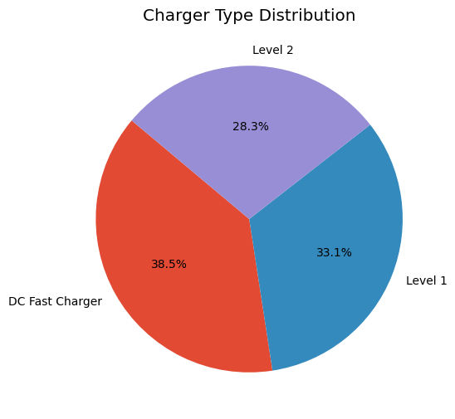
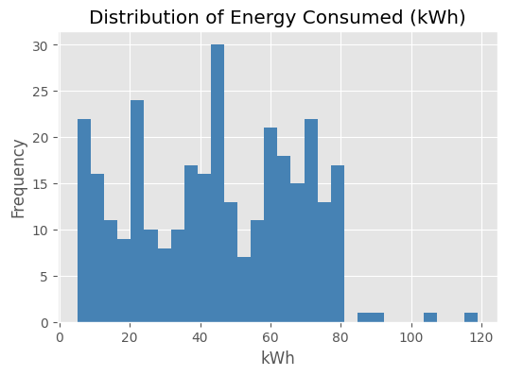
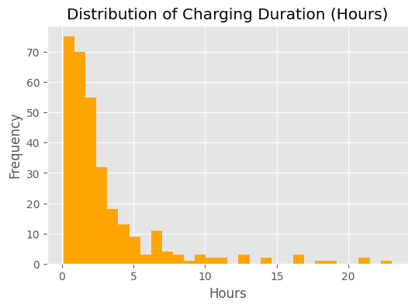
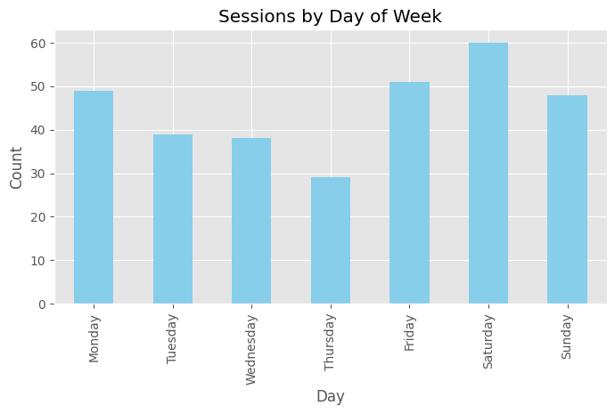
Results

Slide 17
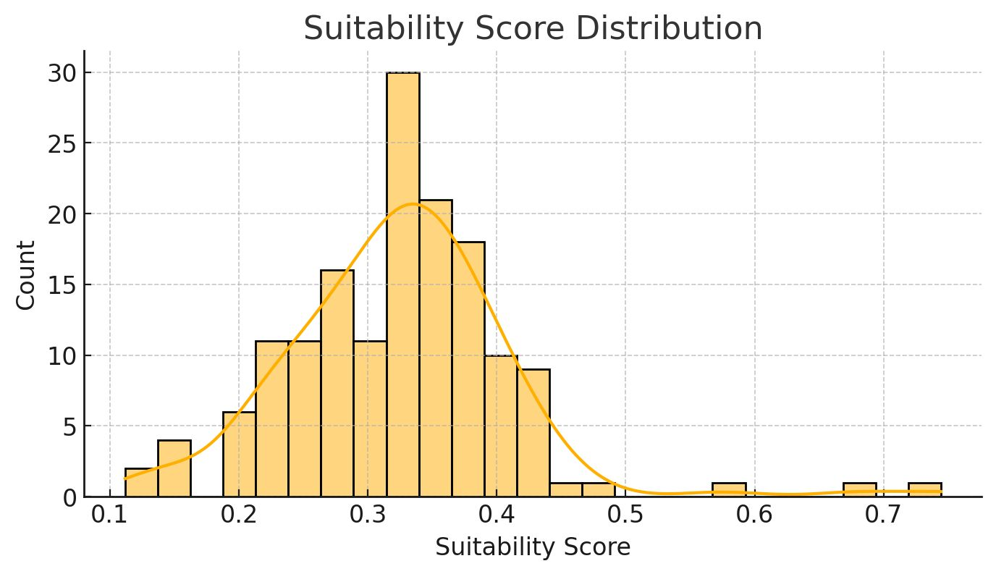
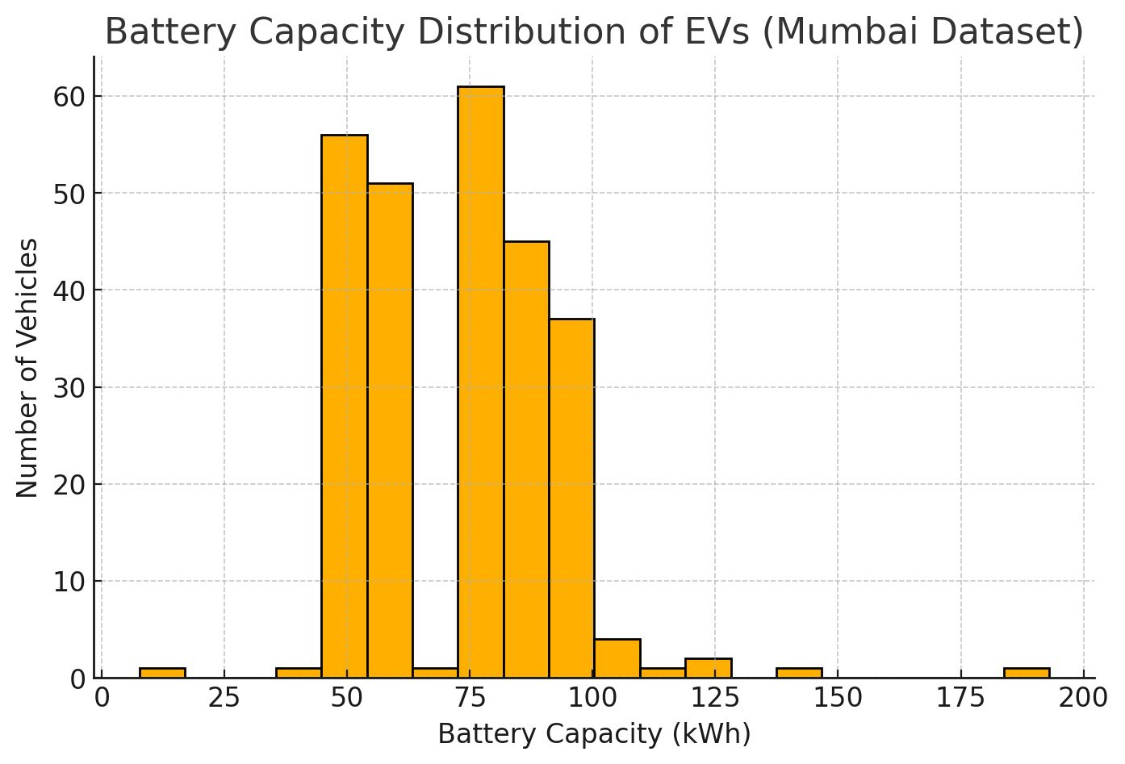

Slide 18
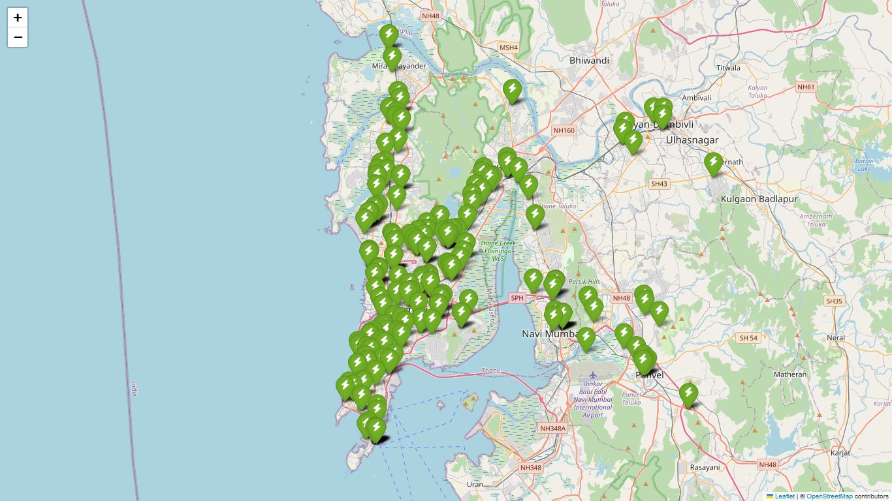
Existing Charging Stations

Slide 19
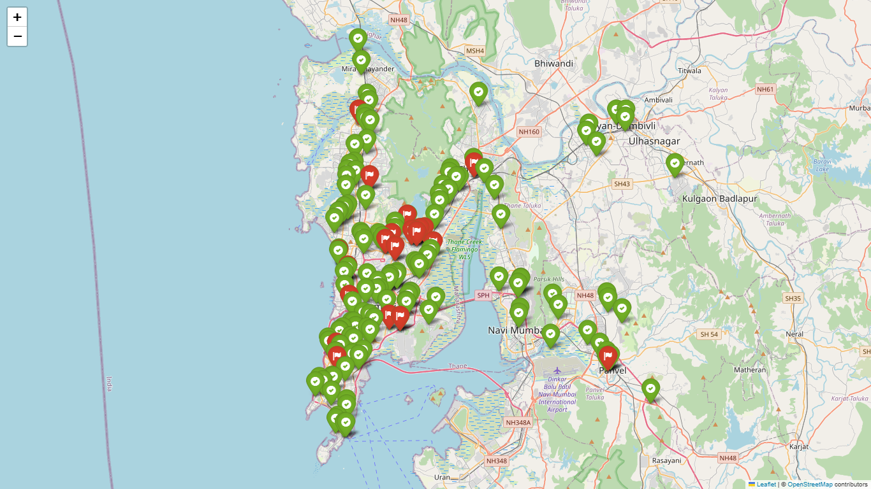
Predicted Stations

Slide 20
Project Plan (Remaining Work)
Phase 1: Model Improvement
Hyperparameter tuning (GridSearch, RandomizedSearch).
Making more use of Data.
Try advanced models (XGBoost, RandomForest, LinearRegression, Gradient Boosting).
Improve accuracy beyond 60% baseline.
Phase 2: Model Benchmarking
Compare multiple ML models on same dataset.
Evaluate using RMSE, MAE, R², and accuracy metrics.
Select best-performing model for deployment.
Phase 3: Dashboard Enhancement
Add advanced filters (region, demand range, time).
Improve visualizations (dynamic heatmaps, interactive scoring).
Phase 4: Research & Publication
Document methodology, results, and comparisons.
Draft and submit research paper to a conference/journal.
Phase 5: Scalability & Final Deployment
Extend analysis to more cities/regions.
Optimize backend for large-scale datasets.
Prepare final polished version for project submission.

Slide 21
Acknowledgement
We would like to express our heartfelt thanks to everyone who has supported us during the initial stages of our capstone project:
Prof. Anjana Rodrigues, our Project Mentor and Project In-Charge, for her continuous guidance, motivation, and valuable inputs during the planning and conceptualization phase.
Dr. Avanish More, Head of the Department, for providing us with the opportunity and resources to undertake this project.
We also acknowledge the authors and organizations whose open-source research papers and technical documents—accessed from platforms like IEEE Xplore and MDPI—have helped us build a strong foundation for our work.
We look forward to continued support as we progress toward the successful execution of our project.

Slide 22
References
S. Sanami, F. Biral and J. M. Bass, “Demand Forecasting for Electric Vehicle Charging Stations using Multivariate Time-Series Analysis,” IEEE Access, vol. 11, pp. 54160-54174, 2023.
M. van Etten, P. Holvoet, W. Joosen and T. Verbelen, “Large-Scale Forecasting of Electric Vehicle Charging Demand Using Global Time Series Modeling,” IEEE Transactions on Smart Grid, vol. 15, no. 1, pp. 789-799, Jan. 2024.
S. Patsavellas and T. Salonitis, “Forecasting Electric Vehicle Charging Demand in Smart Cities,” Energies, vol. 15, no. 2, pp. 875-890, Jan. 2022.
S. K. Nayak, S. K. Padhy and B. K. Panigrahi, “Power consumption prediction for electric vehicle charging stations using time series models,” Energy, vol. 237, pp. 121523, Jan. 2021.
S. Zhang, Q. Shi, Y. Zhang, Q. Liu and H. Endo, “Electric vehicle charging demand forecasting at charging stations considering climate influences,” Energy, vol. 295, 2023, Art. no. 117198.
A. Zeydan and M. Uzar, “Short-Term Forecasting of Electric Vehicle Load Using Machine Learning Techniques,” International Journal of Electrical Power & Energy Systems, vol. 130, pp. 106939, July 2021.

Slide 23
Reference Links
https://www.data.gov.in/resource/stateut-wise-number-electric-vehicle-ev-charging-stations-installed-01-03-2025
https://evyatra.beeindia.gov.in/public-charging-stations/
https://www.plugshare.com/
https://www.cardekho.com/electric-charging-station/mumbai
https://www.kaggle.com/datasets/saketpradhan/electric-vehicle-charging-stations-in-india

Slide 24
THANK YOU

